Slide 1

XSL
APS
By Paul Aviles
Notes:
1

Slide 2

FIRST... Lets understand what XSL is

Slide 3

FIRST... Lets understand what's XSL
XSL stands for EXtensible Stylesheet Language. It is used to parse and transform XML data to documents that can be later understood by other platforms.
But how is it used by CAREERBUILDER?
Simple! We transform the information given by the clients to the format used by DPI, which is the platform where the jobs are posted.
3
© 2015 CareerBuilder
Notes:
Search account by DID or Email
Select the Add Users option
Fill in “New User Info” with first, last name and email
Grant Permissions if requested and hit “Add” before hitting “Save”
To change password, go to users and click on the user you have just created and click on change email/password
Enter the password and confirm it. Once you have confirmed it click update
Send the welcome email to the client if the Account Manager requests you to do so, if not send the user and password to the Account Manager
3

Slide 4

FIRST... Lets understand what's XSL
ADVANTAGES
The information processed by XSL is always guaranteed to work since XML data follow standard structures that are subject to a computer software rather than human action.
It is as flexible as mapping from APS.
DISADVANTAGE
At first, you might find difficult to understand XML data since it is required to have a technical background and is meant to be handled by programmers or related specialists. However, after finishing this presentation, you shouldn't have issues understanding the basics.
4
© 2015 CareerBuilder
Notes:
Search account by DID or Email
Select the Add Users option
Fill in “New User Info” with first, last name and email
Grant Permissions if requested and hit “Add” before hitting “Save”
To change password, go to users and click on the user you have just created and click on change email/password
Enter the password and confirm it. Once you have confirmed it click update
Send the welcome email to the client if the Account Manager requests you to do so, if not send the user and password to the Account Manager
4

Slide 5

Now, what's XML?
(If you already familiar with it, feel free to skip this section)

Slide 6
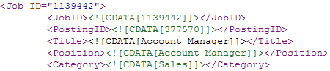
Now, what's XML?
XML stands for eXtensible Markup Language, which is a software- and hardware-independent tool for storing and transporting data.
The basic building block of an XML document is an element, defined by tags. An element has a beginning and an ending tag.
Most of them look like this:
As you can see, there are many tags like <JobID> within the document, each one contains a unique piece of information about the job that can be the position ID, Title, Category and many others!
6
© 2015 CareerBuilder
Notes:
Search account by DID or Email
Select the Add Users option
Fill in “New User Info” with first, last name and email
Grant Permissions if requested and hit “Add” before hitting “Save”
To change password, go to users and click on the user you have just created and click on change email/password
Enter the password and confirm it. Once you have confirmed it click update
Send the welcome email to the client if the Account Manager requests you to do so, if not send the user and password to the Account Manager
6

Slide 7
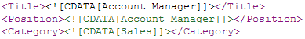
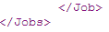
Now, what's XML?
Structure of an XML
1) A prolog defines the XML version and the character encoding:
2) The next line is usually the root element of the document (<Jobs>):
3) The next line starts a <Job> element:
4) The <Job> element can have as many child elements as needed:
5) We close the <Job> element with </Job> and the same with </Jobs>
7
© 2015 CareerBuilder
Notes:
Search account by DID or Email
Select the Add Users option
Fill in “New User Info” with first, last name and email
Grant Permissions if requested and hit “Add” before hitting “Save”
To change password, go to users and click on the user you have just created and click on change email/password
Enter the password and confirm it. Once you have confirmed it click update
Send the welcome email to the client if the Account Manager requests you to do so, if not send the user and password to the Account Manager
7

Slide 8
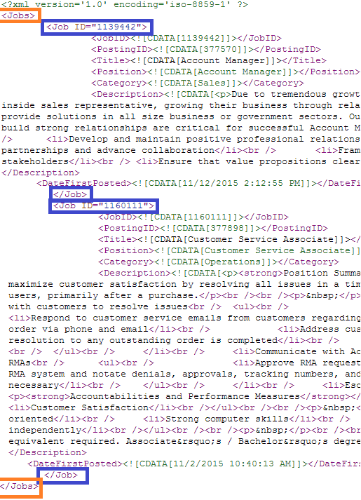
Now, what's XML?
Each job is usually contained
within a tag. This tag contains a collection of every job. We called it root element in the previous slide.
In the following example, the tag that contains this collection is called “Jobs” (Orange square).
The tag “Job” merely contains information of a single job. (Blue square).
8
© 2015 CareerBuilder
Notes:
Search account by DID or Email
Select the Add Users option
Fill in “New User Info” with first, last name and email
Grant Permissions if requested and hit “Add” before hitting “Save”
To change password, go to users and click on the user you have just created and click on change email/password
Enter the password and confirm it. Once you have confirmed it click update
Send the welcome email to the client if the Account Manager requests you to do so, if not send the user and password to the Account Manager
8

Slide 9

How do we identify a candidate for XSL?

Slide 10

How do we identify a candidate for XSL?
The WEB address
Once received the URL address of the career site, if it is an XML document, it might contain keywords that will help you identifying it as an XML.
These are:
feed
xml (or the of the address says .XML)
rss
10
© 2015 CareerBuilder
Notes:
Search account by DID or Email
Select the Add Users option
Fill in “New User Info” with first, last name and email
Grant Permissions if requested and hit “Add” before hitting “Save”
To change password, go to users and click on the user you have just created and click on change email/password
Enter the password and confirm it. Once you have confirmed it click update
Send the welcome email to the client if the Account Manager requests you to do so, if not send the user and password to the Account Manager
10

Slide 11
How do we identify a candidate for XSL?
The WEB address
Examples:
Examples of XML sites without hints:
11
© 2015 CareerBuilder
Notes:
Search account by DID or Email
Select the Add Users option
Fill in “New User Info” with first, last name and email
Grant Permissions if requested and hit “Add” before hitting “Save”
To change password, go to users and click on the user you have just created and click on change email/password
Enter the password and confirm it. Once you have confirmed it click update
Send the welcome email to the client if the Account Manager requests you to do so, if not send the user and password to the Account Manager
11

Slide 12
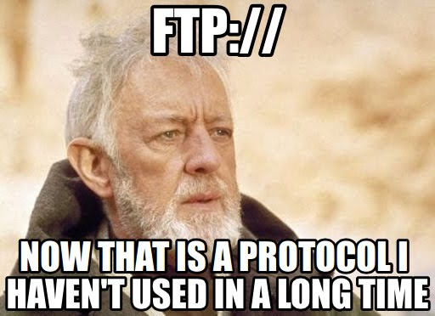
How do we identify a candidate for XSL?
The FTP address
There are rare occasions where the clients prefer using a safer method to provide us their jobs. In this case, they would use an FTP server. FTP stands for File Transfer Protocol; in this case it's used to access an XML file by using login credentials. You can use a web browser to connect to FTP addresses exactly as you would to connect to WEB addresses.
Example of an FTP address:
URL: ftp://ftp.tmpwebeng.com
File path (XML file name): Bergman_XML.xml
Username: sant123
Password: clank123
12
© 2015 CareerBuilder
Notes:
Search account by DID or Email
Select the Add Users option
Fill in “New User Info” with first, last name and email
Grant Permissions if requested and hit “Add” before hitting “Save”
To change password, go to users and click on the user you have just created and click on change email/password
Enter the password and confirm it. Once you have confirmed it click update
Send the welcome email to the client if the Account Manager requests you to do so, if not send the user and password to the Account Manager
12

Slide 13
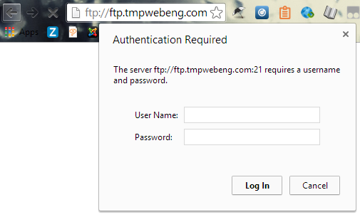
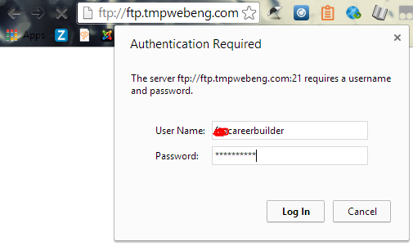
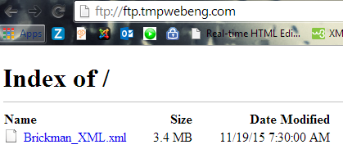
How do we identify a candidate for XSL?
The FTP address
This is how you connect to an FTP address:
1. Type the address on the URL bar and press enter
2. Enter the provided user name and password and click “Log In”
3. Identify the XML file that you will finally use for XSL
13
© 2015 CareerBuilder
Notes:
Search account by DID or Email
Select the Add Users option
Fill in “New User Info” with first, last name and email
Grant Permissions if requested and hit “Add” before hitting “Save”
To change password, go to users and click on the user you have just created and click on change email/password
Enter the password and confirm it. Once you have confirmed it click update
Send the welcome email to the client if the Account Manager requests you to do so, if not send the user and password to the Account Manager
13

Slide 14
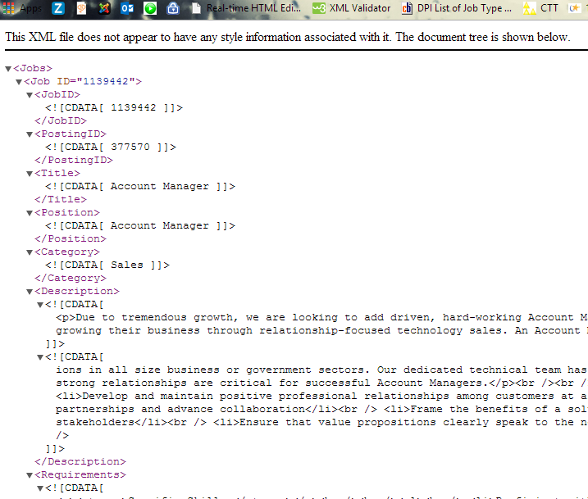
How do we identify a candidate for XSL?
The XML document
How does it looks like?
ON...
GOOGLE CHROME
14
© 2015 CareerBuilder
Notes:
Search account by DID or Email
Select the Add Users option
Fill in “New User Info” with first, last name and email
Grant Permissions if requested and hit “Add” before hitting “Save”
To change password, go to users and click on the user you have just created and click on change email/password
Enter the password and confirm it. Once you have confirmed it click update
Send the welcome email to the client if the Account Manager requests you to do so, if not send the user and password to the Account Manager
14

Slide 15
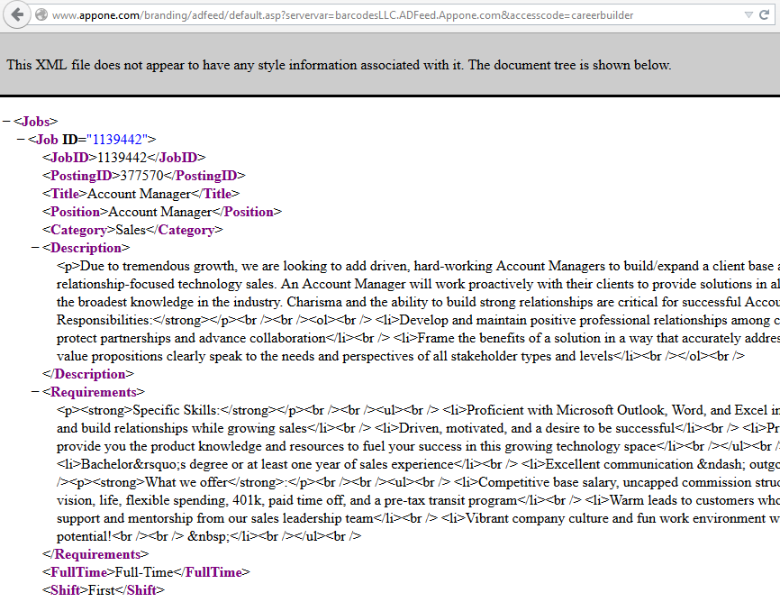
How do we identify a candidate for XSL?
ON...
MOZILLA FIREFOX
15
© 2015 CareerBuilder
Notes:
Search account by DID or Email
Select the Add Users option
Fill in “New User Info” with first, last name and email
Grant Permissions if requested and hit “Add” before hitting “Save”
To change password, go to users and click on the user you have just created and click on change email/password
Enter the password and confirm it. Once you have confirmed it click update
Send the welcome email to the client if the Account Manager requests you to do so, if not send the user and password to the Account Manager
15

Slide 16
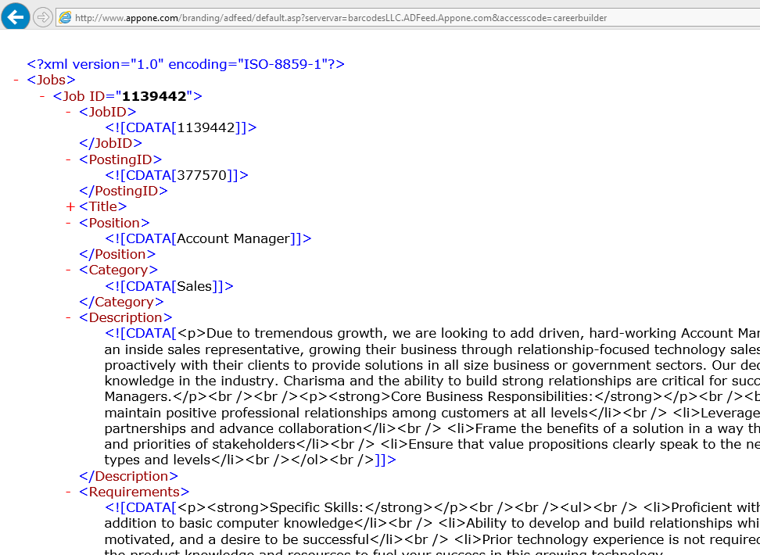

How do we identify a candidate for XSL?
ON...
INTERNET EXPLORER
16
© 2015 CareerBuilder
Notes:
Search account by DID or Email
Select the Add Users option
Fill in “New User Info” with first, last name and email
Grant Permissions if requested and hit “Add” before hitting “Save”
To change password, go to users and click on the user you have just created and click on change email/password
Enter the password and confirm it. Once you have confirmed it click update
Send the welcome email to the client if the Account Manager requests you to do so, if not send the user and password to the Account Manager
16

Slide 17
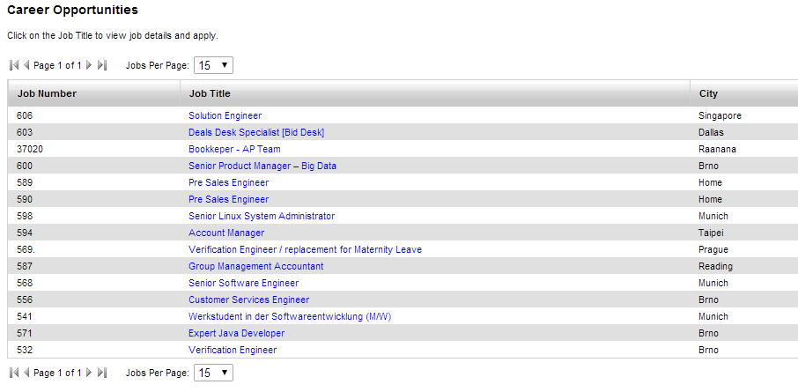
How do we identify a candidate for XSL?
However, this is not an XML. This does not go to XSL.
NOT XML
17
© 2015 CareerBuilder
Notes:
Search account by DID or Email
Select the Add Users option
Fill in “New User Info” with first, last name and email
Grant Permissions if requested and hit “Add” before hitting “Save”
To change password, go to users and click on the user you have just created and click on change email/password
Enter the password and confirm it. Once you have confirmed it click update
Send the welcome email to the client if the Account Manager requests you to do so, if not send the user and password to the Account Manager
17

Slide 18
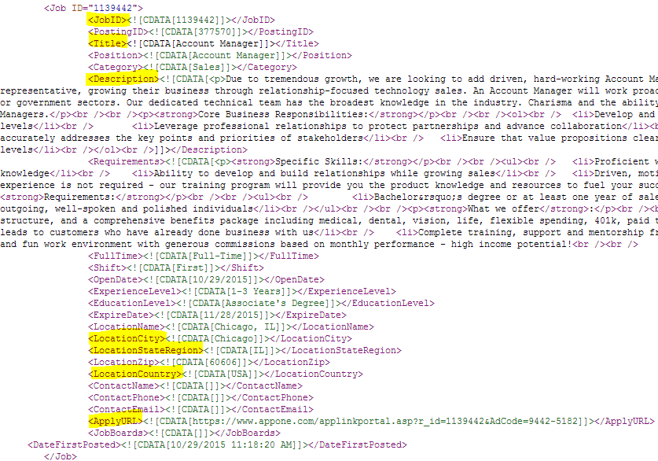

How do we identify a candidate for XSL?
Now that we know how to open and identify an XML, lets make sure that
it contains the Fab 5 (ID, Title, Description, Location, apply URL)
18
© 2015 CareerBuilder
Notes:
Search account by DID or Email
Select the Add Users option
Fill in “New User Info” with first, last name and email
Grant Permissions if requested and hit “Add” before hitting “Save”
To change password, go to users and click on the user you have just created and click on change email/password
Enter the password and confirm it. Once you have confirmed it click update
Send the welcome email to the client if the Account Manager requests you to do so, if not send the user and password to the Account Manager
18

Slide 19
How do we identify a candidate for XSL?
GREAT!
We found the perfect candidate for XSL!
Now lets follow the normal procedure:
Please send an e-mail at APS@careerbuilder.com to request the creation of a new XSL request with the following information:
a) The URL address
b) Additional instructions (filters, default values, etc)
c) The account DID
d) Destination (Talent Network, US, Canada, or other country/site)
19
© 2015 CareerBuilder
Notes:
Search account by DID or Email
Select the Add Users option
Fill in “New User Info” with first, last name and email
Grant Permissions if requested and hit “Add” before hitting “Save”
To change password, go to users and click on the user you have just created and click on change email/password
Enter the password and confirm it. Once you have confirmed it click update
Send the welcome email to the client if the Account Manager requests you to do so, if not send the user and password to the Account Manager
19

Slide 20
How do we identify a candidate for XSL?
Before finishing this section, please note the following:
Some career sites that are not XML sites might be able to generate an
XML feed, you can request an special access to those feeds to the client.
We encourage the use of XML because as mentioned before, the information processed by XSL is always guaranteed to work since XML data follows standard structures that are subject to a computer software rather than human action. Making the process of posting jobs more reliable, safe and fun!
20
© 2015 CareerBuilder
Notes:
Search account by DID or Email
Select the Add Users option
Fill in “New User Info” with first, last name and email
Grant Permissions if requested and hit “Add” before hitting “Save”
To change password, go to users and click on the user you have just created and click on change email/password
Enter the password and confirm it. Once you have confirmed it click update
Send the welcome email to the client if the Account Manager requests you to do so, if not send the user and password to the Account Manager
20

Slide 21

Let's get more technical.
How is XSL done?

Slide 22

How is XSL done?
At APS, we use the following tools to develop XSL:
Notepad++
FAT Tool (Cloud Atlas)
Other useful tools:
XSL and XML syntax checkers
http://www.utilities-online.info/xsltransformation/
22
© 2015 CareerBuilder
Notes:
Search account by DID or Email
Select the Add Users option
Fill in “New User Info” with first, last name and email
Grant Permissions if requested and hit “Add” before hitting “Save”
To change password, go to users and click on the user you have just created and click on change email/password
Enter the password and confirm it. Once you have confirmed it click update
Send the welcome email to the client if the Account Manager requests you to do so, if not send the user and password to the Account Manager
22

Slide 23


How is XSL done?
Notepad++ is a very efficient code editor
since it supports many encoding and language
patterns for XML and XSL.
FAT tool is the tool provided by Career Builder to:
1) Retrieve XML files from external sources such as
web addresses or FTP files.
2) Use an XSL code to parse and transform the
Information of the retrieved XML file
3) Lastly, publish the transformed jobs by sending
them DPI.
23
© 2015 CareerBuilder
Notes:
Search account by DID or Email
Select the Add Users option
Fill in “New User Info” with first, last name and email
Grant Permissions if requested and hit “Add” before hitting “Save”
To change password, go to users and click on the user you have just created and click on change email/password
Enter the password and confirm it. Once you have confirmed it click update
Send the welcome email to the client if the Account Manager requests you to do so, if not send the user and password to the Account Manager
23

Slide 24
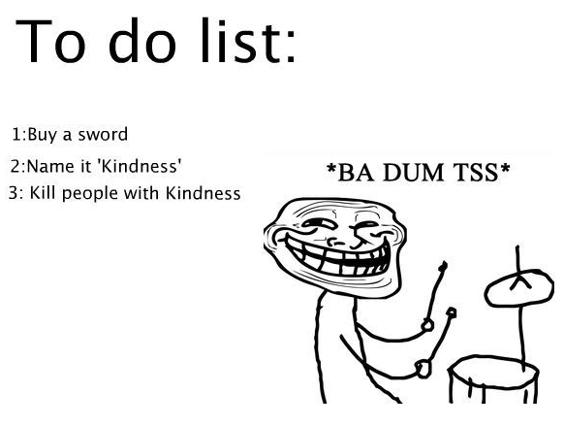
How is XSL done?
Getting Started
We require the elements below:
1) A CB account
2) A bulkposter and its vendor ID (All linked to the CB account)
3) A map request
4) A valid XML file address
5) A functional XSL code
24
© 2015 CareerBuilder
Notes:
Search account by DID or Email
Select the Add Users option
Fill in “New User Info” with first, last name and email
Grant Permissions if requested and hit “Add” before hitting “Save”
To change password, go to users and click on the user you have just created and click on change email/password
Enter the password and confirm it. Once you have confirmed it click update
Send the welcome email to the client if the Account Manager requests you to do so, if not send the user and password to the Account Manager
24

Slide 25
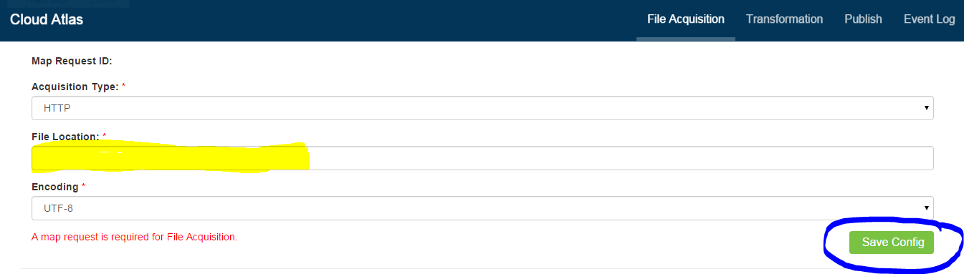
How is XSL done?
Assuming we also already have the 4 first elements too. Let's start!
We access FAT Tool by using the URL address above and type the map request DID on the yellow highlight.
Copy and paste the web address containing the XML at the File Location field and click Save Config to save the configurations.
25
© 2015 CareerBuilder
Notes:
Search account by DID or Email
Select the Add Users option
Fill in “New User Info” with first, last name and email
Grant Permissions if requested and hit “Add” before hitting “Save”
To change password, go to users and click on the user you have just created and click on change email/password
Enter the password and confirm it. Once you have confirmed it click update
Send the welcome email to the client if the Account Manager requests you to do so, if not send the user and password to the Account Manager
25

Slide 26
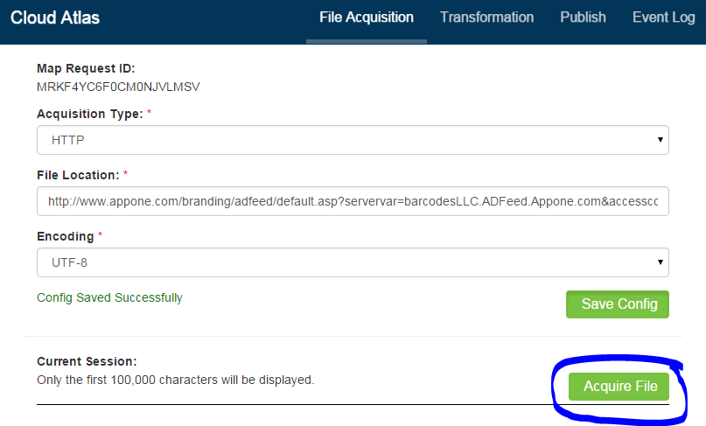
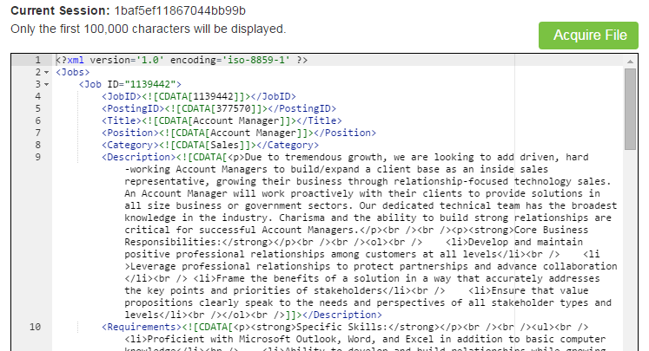
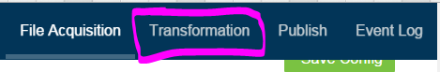
How is XSL done?
Now click Acquire File, this will allow us to download the XML file
Perfect!, we can proceed transforming the information, please click the next button at the top of the site:
26
© 2015 CareerBuilder
Notes:
Search account by DID or Email
Select the Add Users option
Fill in “New User Info” with first, last name and email
Grant Permissions if requested and hit “Add” before hitting “Save”
To change password, go to users and click on the user you have just created and click on change email/password
Enter the password and confirm it. Once you have confirmed it click update
Send the welcome email to the client if the Account Manager requests you to do so, if not send the user and password to the Account Manager
26

Slide 27
How is XSL done?
Now click Acquire File, this will allow us to download the XML file
Perfect!, we can proceed transforming the information, please click the next button at the top of the site:
27
© 2015 CareerBuilder
Notes:
Search account by DID or Email
Select the Add Users option
Fill in “New User Info” with first, last name and email
Grant Permissions if requested and hit “Add” before hitting “Save”
To change password, go to users and click on the user you have just created and click on change email/password
Enter the password and confirm it. Once you have confirmed it click update
Send the welcome email to the client if the Account Manager requests you to do so, if not send the user and password to the Account Manager
27

Slide 28
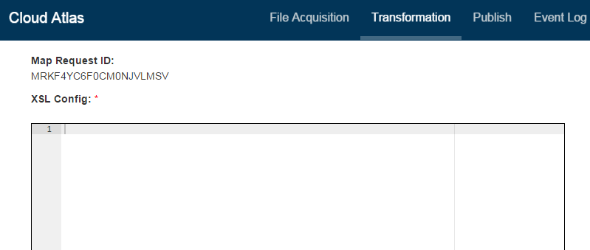
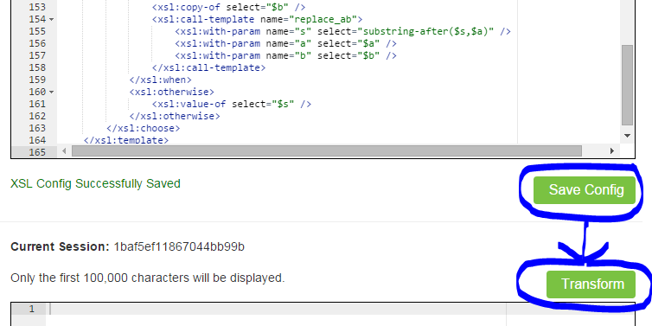
How is XSL done?
Transformation
We copy and paste the XSL
Code the XSL Config field,
then click Save Config to
save the file.
Now click Transform to
transform the XML data to
a format recognizable by
CareerBuilder with the help
of the XSL file we just saved.
28
© 2015 CareerBuilder
Notes:
Search account by DID or Email
Select the Add Users option
Fill in “New User Info” with first, last name and email
Grant Permissions if requested and hit “Add” before hitting “Save”
To change password, go to users and click on the user you have just created and click on change email/password
Enter the password and confirm it. Once you have confirmed it click update
Send the welcome email to the client if the Account Manager requests you to do so, if not send the user and password to the Account Manager
28

Slide 29
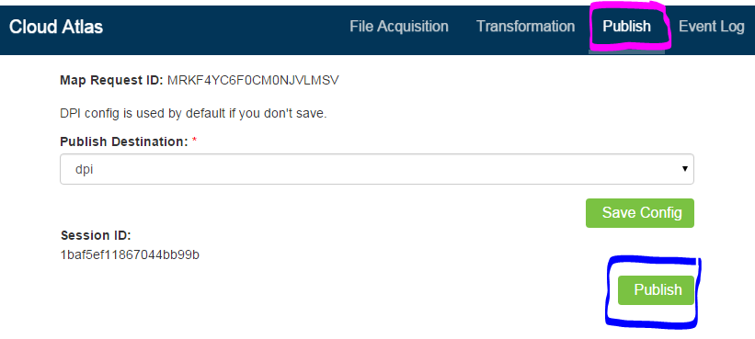
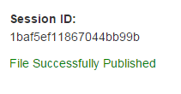
How is XSL done?
Publishing
We go to the publish
site and if everything
was good in the last
Step, we can post the
jobs by clicking
Publish.
29
© 2015 CareerBuilder
Notes:
Search account by DID or Email
Select the Add Users option
Fill in “New User Info” with first, last name and email
Grant Permissions if requested and hit “Add” before hitting “Save”
To change password, go to users and click on the user you have just created and click on change email/password
Enter the password and confirm it. Once you have confirmed it click update
Send the welcome email to the client if the Account Manager requests you to do so, if not send the user and password to the Account Manager
29

Slide 30
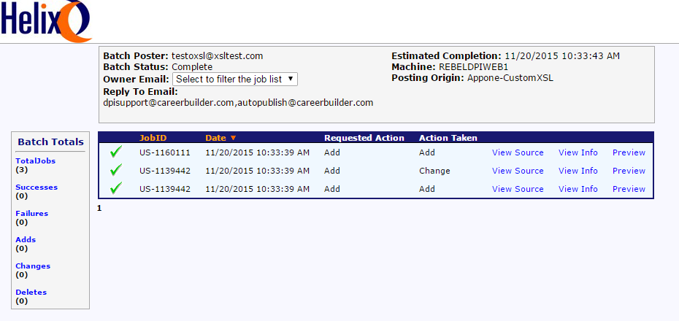

How is XSL done?
Helix
Once the jobs are posted, you can see the results at Helix like on the picture below:
CONGRATULATIONS!
WE DID XSL!
30
© 2015 CareerBuilder
Notes:
Search account by DID or Email
Select the Add Users option
Fill in “New User Info” with first, last name and email
Grant Permissions if requested and hit “Add” before hitting “Save”
To change password, go to users and click on the user you have just created and click on change email/password
Enter the password and confirm it. Once you have confirmed it click update
Send the welcome email to the client if the Account Manager requests you to do so, if not send the user and password to the Account Manager
30

Slide 31

The XSL Code

Slide 32
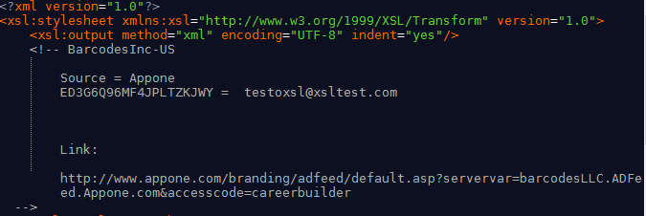
The XSL Code
XSL itself is kind of a programming language only focused on data transformation. An XSL code is built to parse information from the XML data containing the jobs and transform it to a format recognizable by DPI at CareerBuilder.
This is how the XSL code looks like:
32
© 2015 CareerBuilder
Notes:
Search account by DID or Email
Select the Add Users option
Fill in “New User Info” with first, last name and email
Grant Permissions if requested and hit “Add” before hitting “Save”
To change password, go to users and click on the user you have just created and click on change email/password
Enter the password and confirm it. Once you have confirmed it click update
Send the welcome email to the client if the Account Manager requests you to do so, if not send the user and password to the Account Manager
32

Slide 33
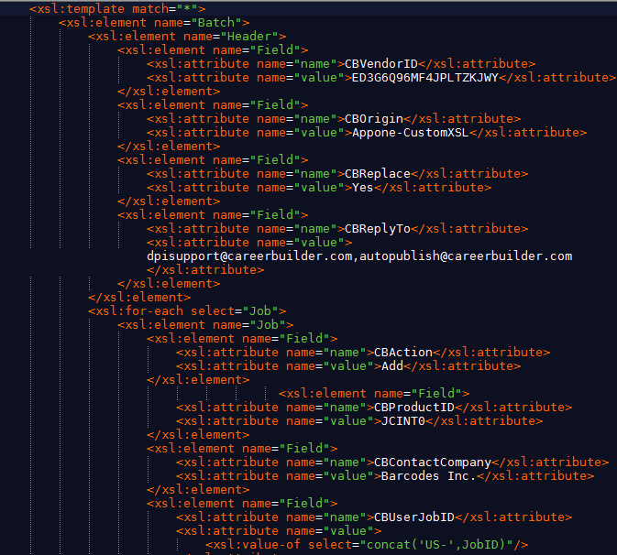
The XSL Code
Like in XML, each tag contains an important value.
This part of the XSL would generate an output as followed:
<Batch>
<Header>
<Field name='CBVendorID' value='ERSFFDAFDAFGDEASF'/>
<Field name='CBReplyTo' value='test@careerbuilder.ocm'/>
</Header>
….
33
© 2015 CareerBuilder
Notes:
Search account by DID or Email
Select the Add Users option
Fill in “New User Info” with first, last name and email
Grant Permissions if requested and hit “Add” before hitting “Save”
To change password, go to users and click on the user you have just created and click on change email/password
Enter the password and confirm it. Once you have confirmed it click update
Send the welcome email to the client if the Account Manager requests you to do so, if not send the user and password to the Account Manager
33

Slide 34
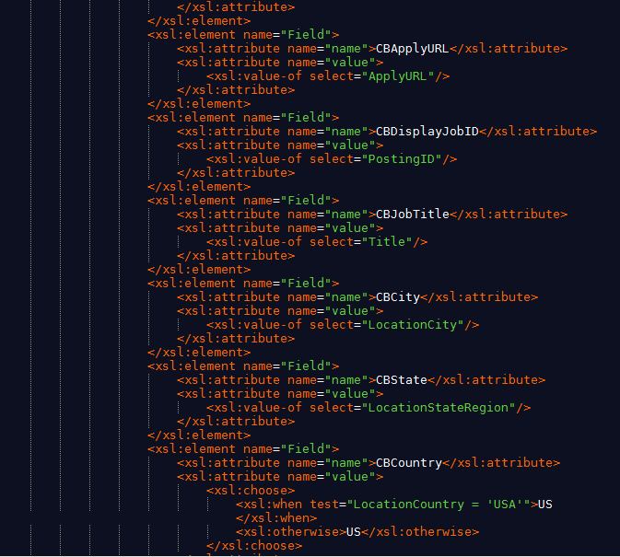
The XSL Code
...
<Field name="CBApplyURL" value="http://jobsite.com" />
<Field name="CBDisplayJobID" value="123" />
<Field name="CBJobTitle" value="TX" />
<Field name="CBCity" value="San Antonio" />
<Field name="CBState" value="CA" />
<Field name="CBCountry" value="US" />
….
34
© 2015 CareerBuilder
Notes:
Need instructions from Corbus
34

Slide 35
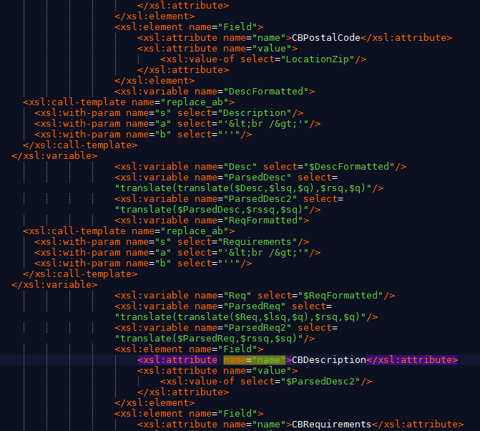
The XSL Code
...
<Field name="CBPostalCode" value="This job is about building stuff" />
<Field name="CBDescription" value="123" />
<Field name="CBRequirements" value="You need tools" />
<Field name="CBCity" value="San Antonio" />
<Field name="CBState" value="CA" />
<Field name="CBCountry" value="US" />
</Batch>
35
© 2015 CareerBuilder
Notes:
Need instructions from Corbus
35

Slide 36
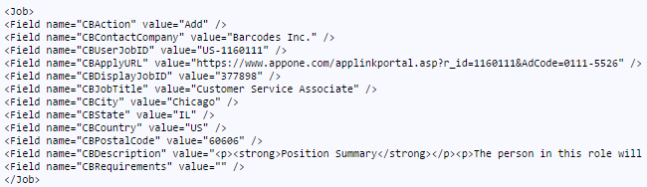
The XSL Code
This is the final result:

Slide 37
QUESTIONS?
© 2015 CareerBuilder

